Slide 1
HEART ATTACK POSSIBILITY

Slide 2
TABLE OF CONTENTS
1
2
General Information of Dataset
Query and Visualize By Tools
3
4
Analysis
Conclusions
Introduce about the dataset in details of columns, values and the substance.
Show steps, code and visualization of dataset
Using data for the question’s analytics
Giving a summary and perspectives

Slide 3
01.
INTRODUCTION

Slide 4
INTRODUCTION
The original dataset contains 76 attributes from survey’s participant including people with and without heart disease. However, there are only 14 published attributes contributing to the dataset. The dataset is Health care: Heart attack possibility from Kaggle. Let’s have a precise look!

Slide 5
DATASET DETAILS
Age: Age of participants
Gender: 0=Female, 1=Male
Cp: Type of Chest Pains (0=Typical Angina, 1= Atypical Angina, 2= Non-Anginal Pain, 3=Asymptomatic
Trestbps: Resting Blood Pressure (mm Hg)
Chol: Serum Cholestoral (mg/dl)
Fbs: Fasting Blood Sugar (>120mg/dl) 0=False, 1=True
Restecg: resting electrocardiographic results 0= Normal, 1= abnormal, 2= probable or definite left ventricular hypertrophy by Estes’ criteria
Notes:
age: Tuổi của một người
giới tính: Giới tính (1 = nam, 0 = nữ)
cp: Các loại đau ngực đã trải qua (Giá trị 1: đau thắt ngực điển hình, Giá trị 2: đau thắt ngực không điển hình, Giá trị 3: đau không đau thắt ngực, Giá trị 4: không có triệu chứng)
trestbps: Huyết áp khi nghỉ ngơi (mm Hg khi nhập viện)
chol: Đo nồng độ cholesterol tính bằng mg / dl
fbs: Đường huyết lúc đói (nếu> 120 mg / dl, 1 = true; 0 = false)
restecg: Đo điện tâm đồ khi nghỉ ngơi (0 = bình thường, 1 = có bất thường sóng ST-T, 2 = hiển thị phì đại thất trái có thể xảy ra hoặc xác định theo tiêu chuẩn của Estes)

Slide 6
DATASET DETAILS
Thalach: Max Bps
Exang: Exercise induced angina 0=No, 1=Yes
Oldpeak: ST depression induced by exercise relative to rest
Slope: the slope of the peak exercise ST segment 0= Unsloping, 1=Flat, 2=Downsloping
Ca: The number of major vessels
Thal: A blood disorder called Thalassemia 1= Normal, 2=Fixed Defect, 3=Revesible Defect
Target: 0=No Heart Disease, 1=Heart Disease
Notes:
thalach: Nhịp tim tối đa đạt được
exang: Đau thắt ngực do tập thể dục (1 = có; 0 = không)
10.oldpeak: ST trầm cảm gây ra do tập thể dục liên quan đến nghỉ ngơi (‘ST’ liên quan đến các vị trí trên đồ thị ECG)
11.slope: độ dốc của đoạn ST tập luyện đỉnh cao (Giá trị 1: dốc lên, Giá trị 2: bằng phẳng, Giá trị 3: dốc xuống)
12.ca: Các mạch máu chính, được tô màu theo Flourrosopy
13.thal: Một chứng rối loạn máu được gọi là thalassemia (1 = bình thường; 2 = khiếm khuyết cố định; 3 = khiếm khuyết có thể hồi phục)
thal: biến mục tiêu Bệnh tim cần dự đoán (0 = không, 1 = có)

Slide 7



TOOLS
MySQL
PowerBI
Python

Slide 8
Analytical Purpose
Purpose
Analyze to figure out the indexes having precise relation with Heart attack
Clean Data
Visualization
Analysis
Remove Null and changing data as demands
Having clear charts for better analysis
Base on the aforementioned visulization to point out the related indexes

Slide 9
2
Query and Visualize By Tools

Slide 10
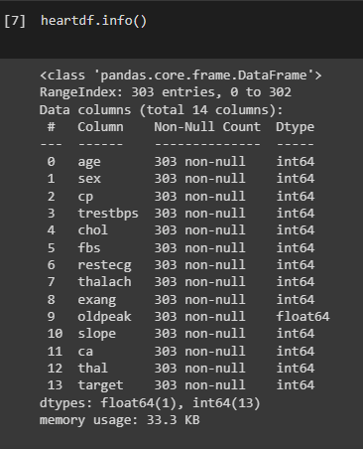
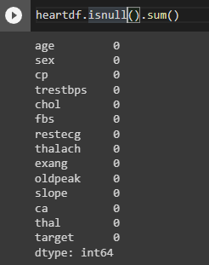
Clean Data
Checking nulls

Slide 11
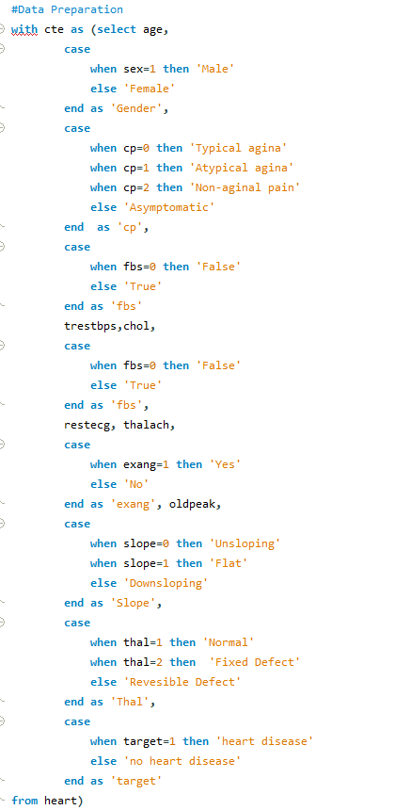
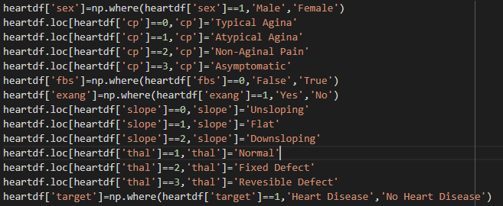

Transform Data Values
Transform numeric values to string from the explanation

Slide 12
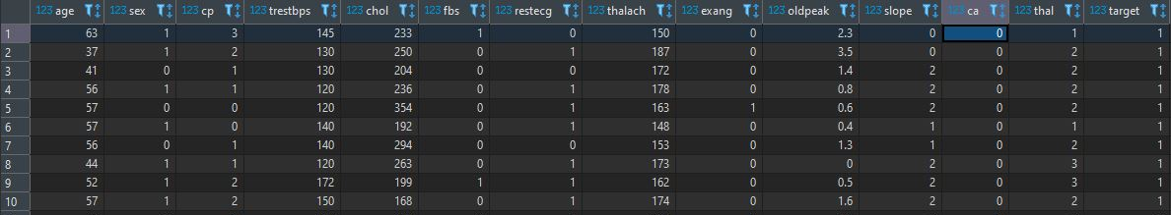
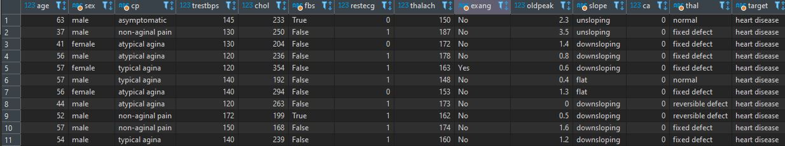
Transform Data Values
Transform numeric values to string from the explanation-Results

Slide 13
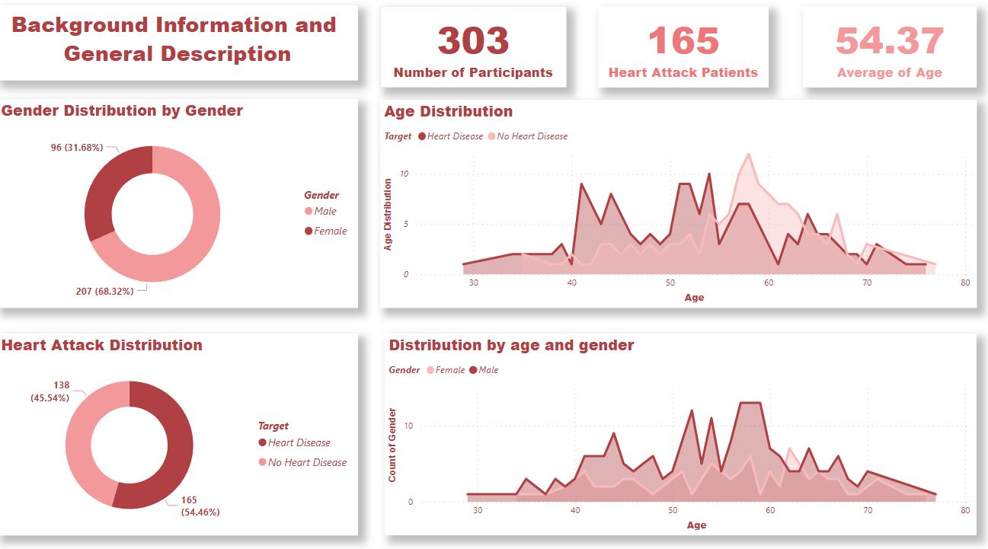
Visulization

Slide 14
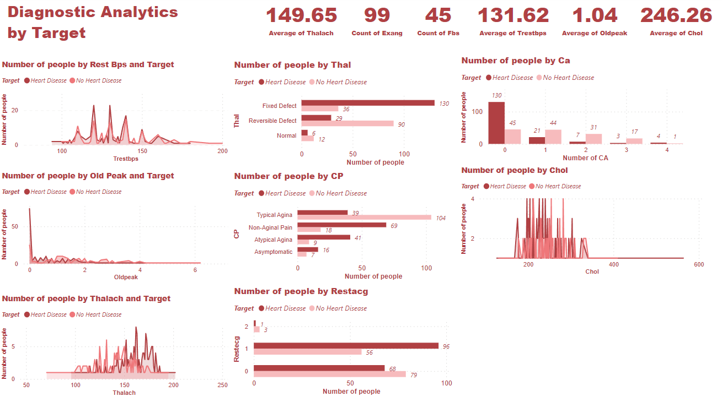
Visulization

Slide 15
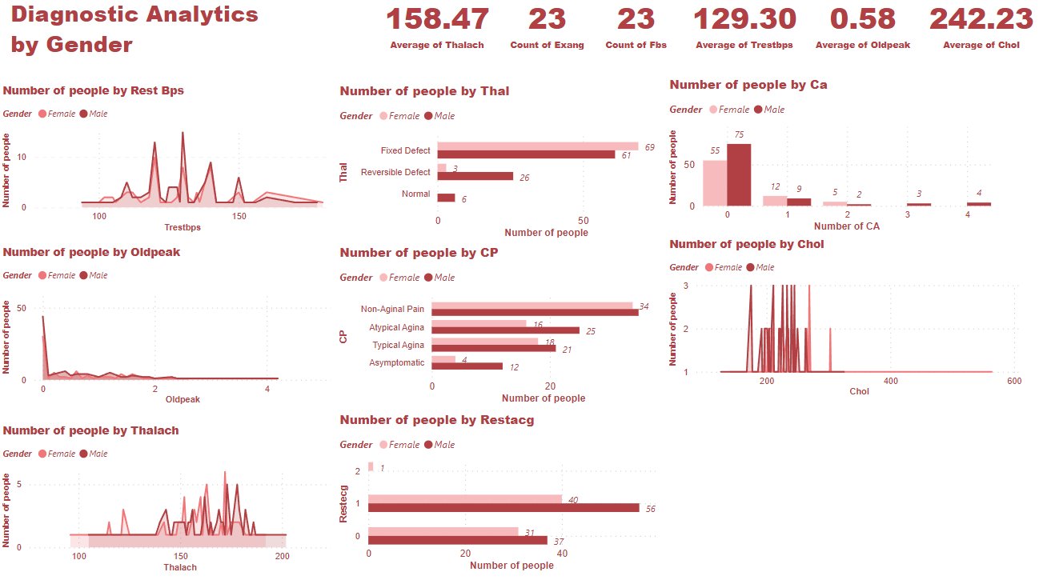
Visulization

Slide 16
03
Analysis

Slide 17
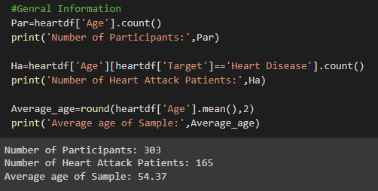
GENERAL

Slide 18
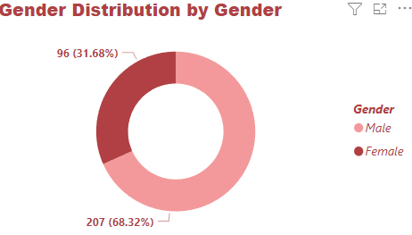
GENERAL

Slide 19
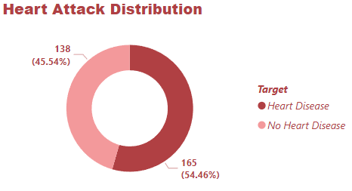
GENERAL

Slide 20
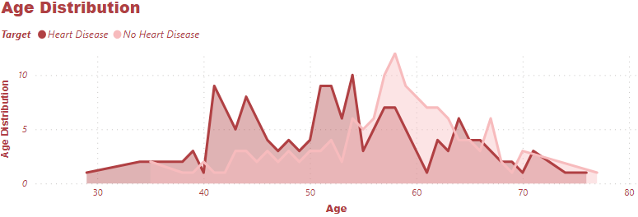
GENERAL
Most of the participants are in middle age

Slide 21
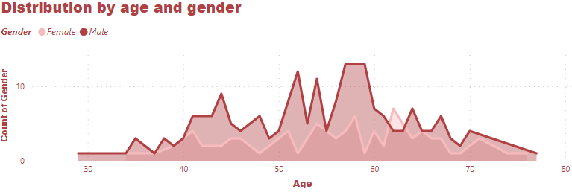
GENERAL

Slide 22
Analytics by Target
Average Max Bps(Thalach) is 149.65
Number of participants having angina from exercise is 99-Exang
Number of participants having fasting blood sugar >120mg/dl is 45-Fbs
Average Resting blood pressure is 131.62
Average ST depression induced by exercise relative to rest is 1.04
Average Serum Cholestoral (mg/dl) is 246.26

Slide 23
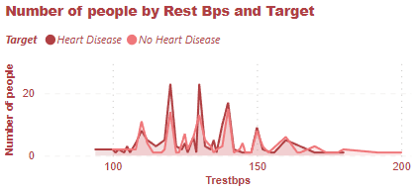
Analytics by Target
There are significant gaps between the Trestbps 120 and 130. The participants had Heart Disease than the rest. However, people who do not have HD can have a higher Trestbps (approx. 200)

Slide 24
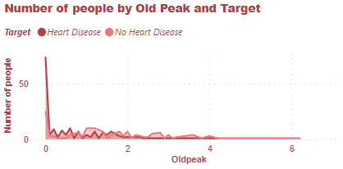
Analytics by Target
The difference of old peak by target reveals a noticeable point. People having HD almost have a lower old peak than the rest.

Slide 25
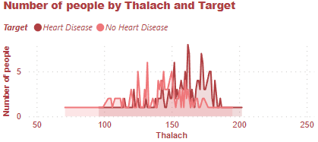
Analytics by Target
The difference of highest bps from both groups has a significant gap. People having heart disease tend to have a higher thalach which is mostly between 160 and 180. Meanwhile, the No HD group has between 140 and 160

Slide 26
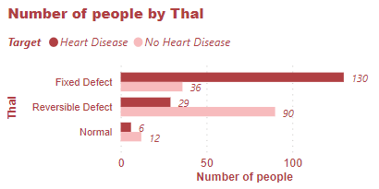
Analytics by Target
The bar chart depicts the difference between HD and no HD people with Thalassemia blood disorder. The HD group has a significantly large number of people having Fixed Defect which is 4 times higher than the NHD group. Meanwhile, the HD group has a much lower number of people getting Reversible Defect and Normal status than NHD people.
Notes:
Khiếm khuyết di truyền trong sự tổng hợp chuỗi globin, làm cho hemoglobin không bình thường, hồng cầu bị vỡ sớm gây thiếu máu. Bệnh được gọi tên theo chuỗi globin bị khiếm khuyết

Slide 27
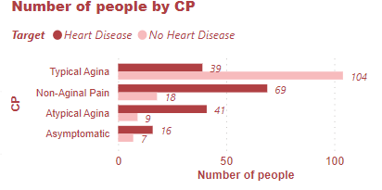
Analytics by Target
The chart reveals the difference between HD and no HD people with Chest Pains. HD group has a number of people at least 2 times higher than NHD in Non-Anginal Pain, Atypical Angina, and Asymptomatic. Meanwhile, the NHD group has 3 times larger in Typical Angina

Slide 28
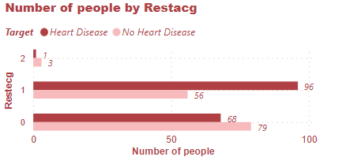
Analytics by Target
Precisely, the HD group has more people having the abnormal ST when resting which is nearly 2 times higher.

Slide 29
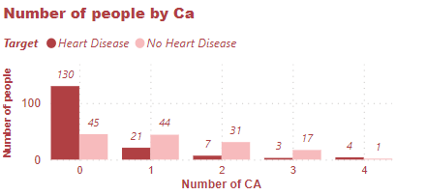
Analytics by Target
Significantly, the HD group has less number of major vessels. Precisely, number of people in the HD group is 3 times higher than the NHD and it decreases steadily.

Slide 30
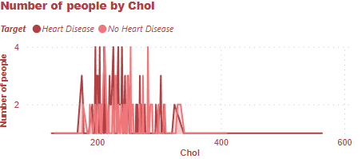
Analytics by Target
There is no significant sign in this index.

Slide 31
Analytics BY GENDER

Slide 32
Analytics by Gender
Average Max Bps(Thalach) is 158.47
Number of participants having angina from exercise is 23-Exang
Number of participants having fasting blood sugar >120mg/dl is 23-Fbs
Average Resting blood pressure is 129.30
Average ST depression induced by exercise relative to rest is 0.58
Average Serum Cholestoral (mg/dl) is 242.23

Slide 33
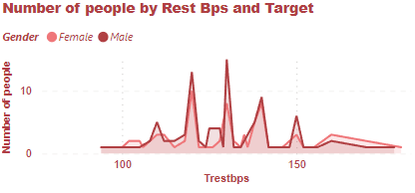
Analytics by Gender
There are significant gaps at the Trestbps 130 and 150. At the aforementioned points, the Male has 2 times higher than the Female.

Slide 34
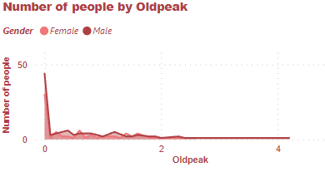
Analytics by Gender
The difference of old peak by target reveals a noticeable point. The Male almost has a lower old peak than the rest.

Slide 35
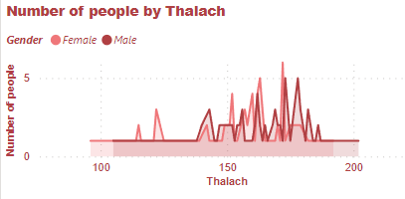
Analytics by Gender
The difference of highest bps from both groups has a significant gap with each other. The Female mostly has a higher Thalach than the Male between 152 and 163. Meanwhile, the Male has a higher Thalach from 173+

Slide 36
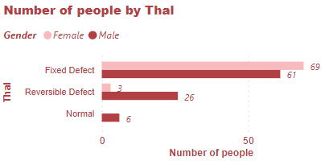
Analytics by Gender
The bar chart depicts the difference between the Male and the Female with Thalassemia blood disorder. The Male group has a significantly large number of people having Reversible Defect which is 8 times higher than the Female group. Meanwhile, Fixed Defect noticed a relative number of males and females. Additionally, the Female group has no participant being normal.

Slide 37
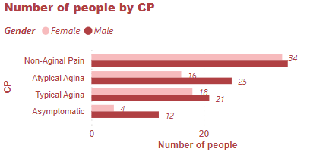
Analytics by Gender
The chart reveals the difference between Male and Female with Chest Pains. The Male group has a number of people significantly higher than the Female in Atypical Pain, and Asymptomatic.

Slide 38
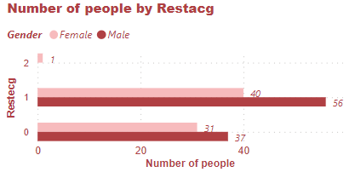
Analytics by Gender
Precisely, the Male group has more people having the abnormal ST when resting which is nearly 1,5 times higher. Moreover, only the Female group has problem with left ventricular hypertrophy by Estes’ criteria.

Slide 39
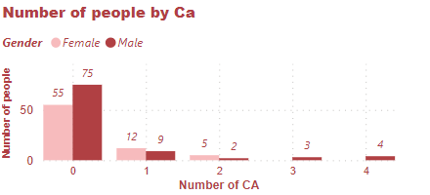
Analytics by Gender
Significantly, the Male group mostly has less number of major vessels. Precisely, number of people having no major vessels in the HD group is much higher than the Female. Additionally, only the minority of male have 3 and 4 major vessels.

Slide 40
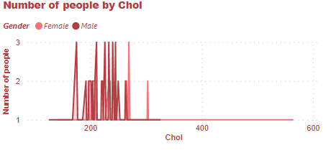
Analytics by Gender
Precisely, the Male group has Cholesterol that under 250. Meanwhile, the Female group has higher than that point.

Slide 41
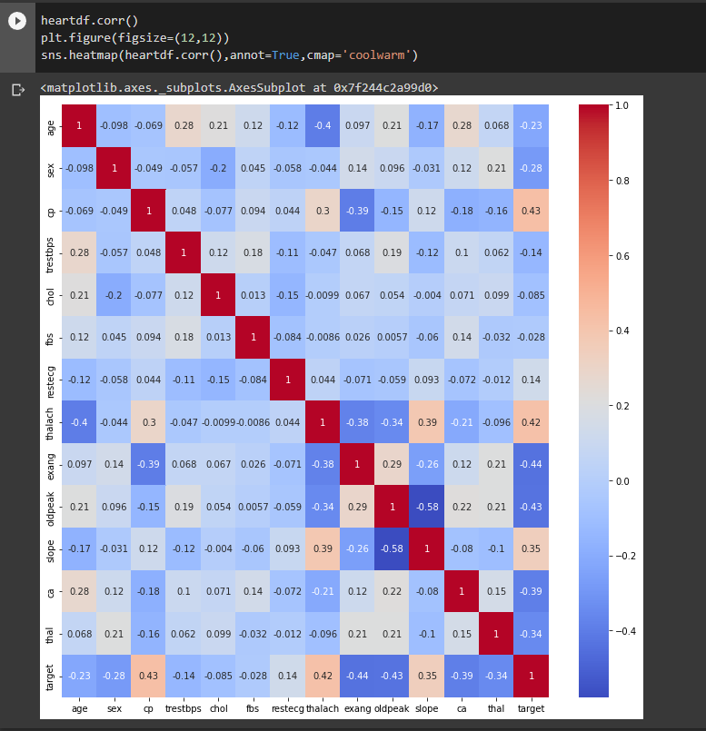
Heatmap Correlation
The heatmap depicts relationship between indexes. Using p-value between indexes and Target to identify relationship between indexes and Heart Disease. Noticeably, there aren’t any strong relationship.
CP and Thalch have positive moderate relationships with Heart Disease. Meanwhile, Exang, Oldpeak, CA, and Thal have a negative moderate relationships.

Slide 42
CONCLUSION
According to the analytics, the serious chest pain(or when doing exercise), the high maximum bps, or less blood vessels could be signals of heart attack.

